Slide 1


Slide 2


Slide 3


Slide 4
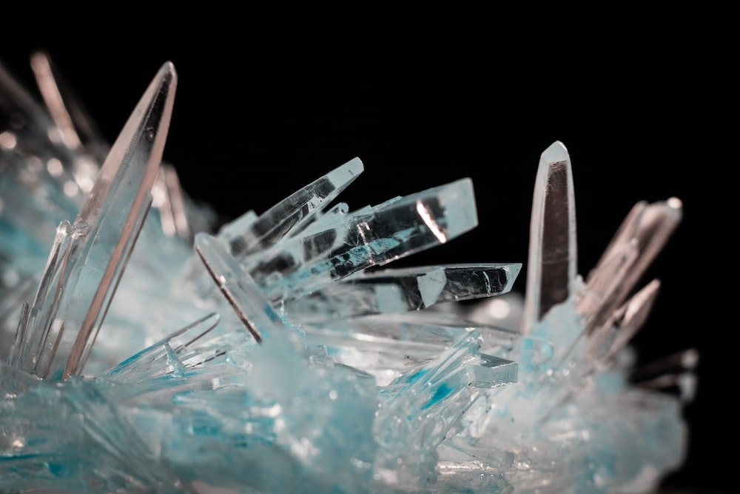

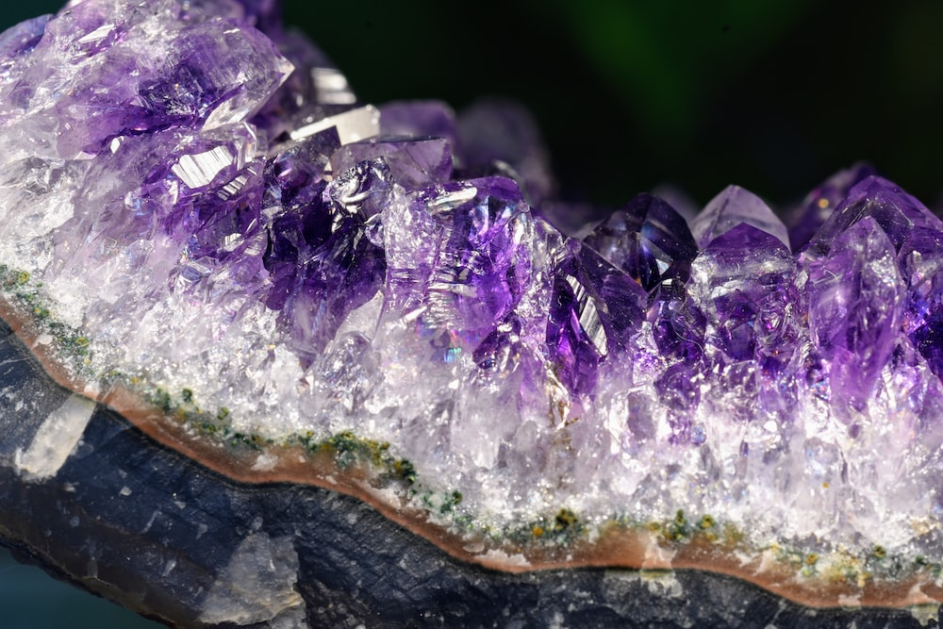

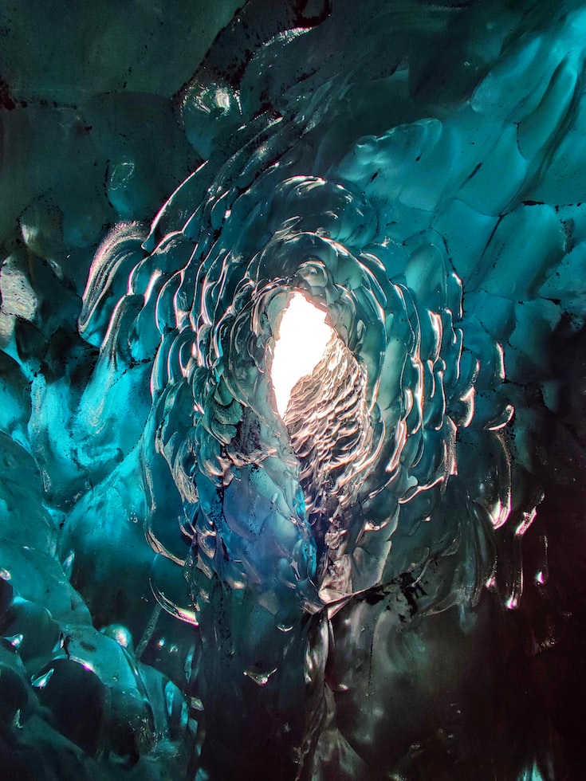



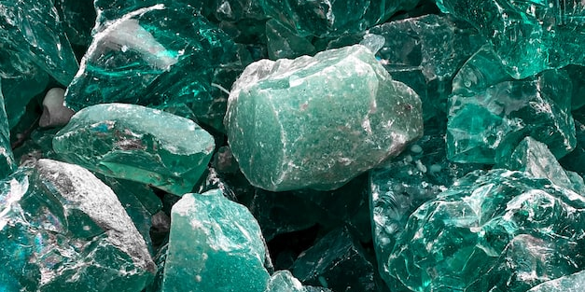

Slide 7


Slide 8


Slide 9


Slide 10
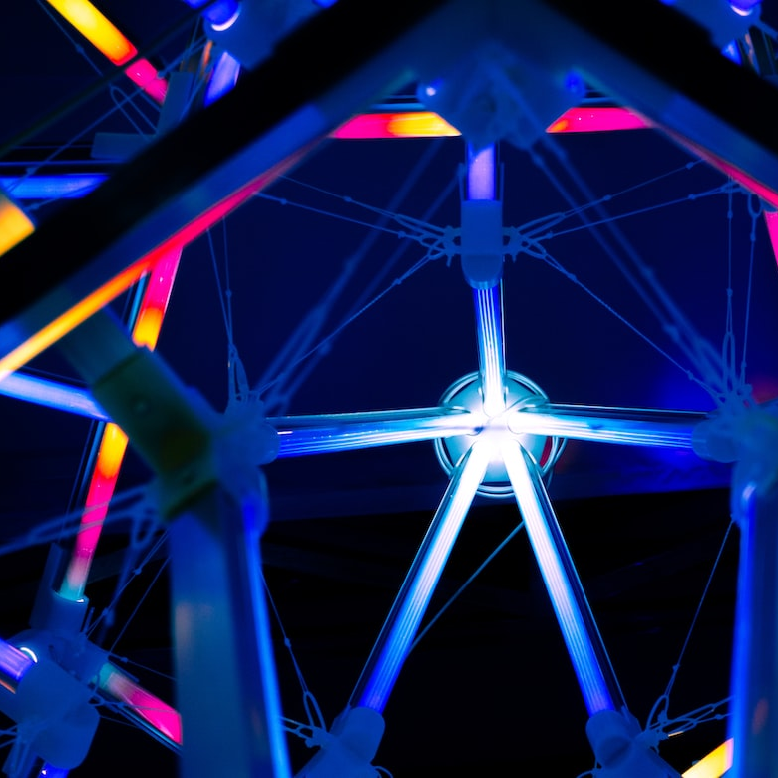

Slide 11


Slide 12


Slide 13


Slide 14
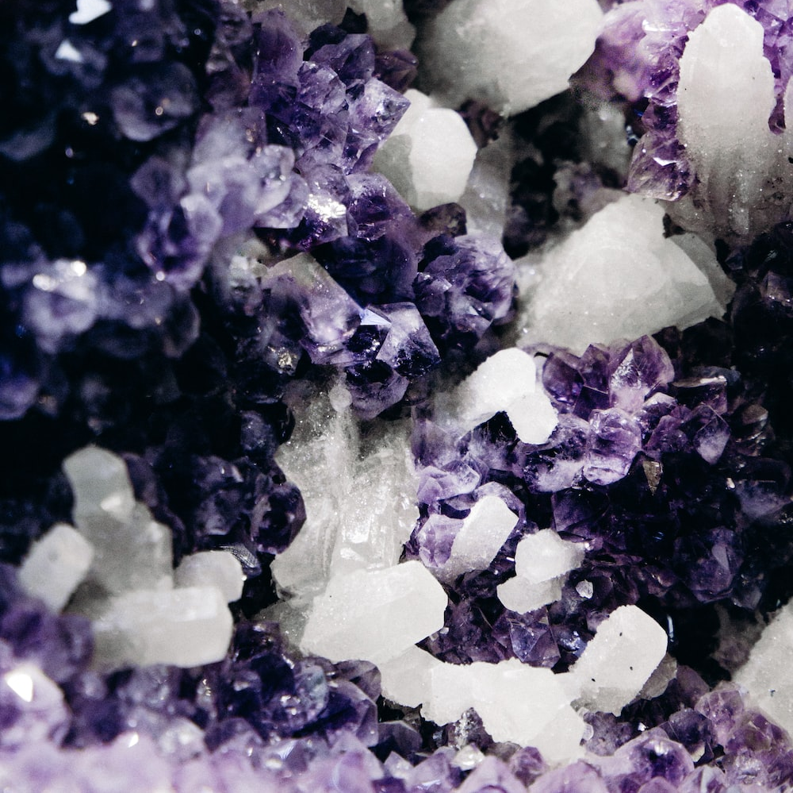

Slide 15


Slide 16
Home
About
CV
Research
PopSci
Blog
Contact

Slide 19


Slide 21
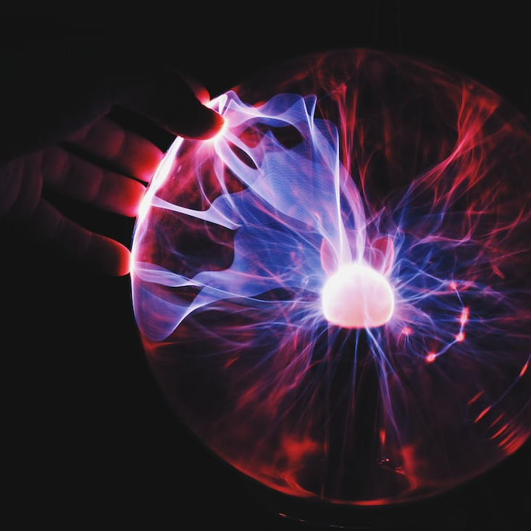

Slide 23


Slide 24



Slide 25



Slide 26





Slide 27


Slide 28
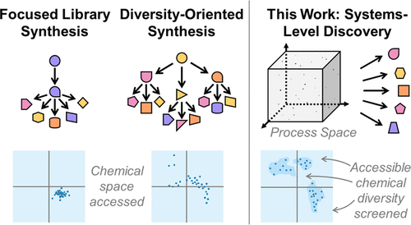

Slide 30


Slide 31

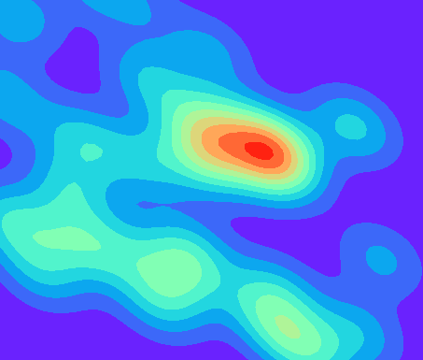

Discovery
Exploration
Interpretation

Slide 32


Slide 33



Slide 34


Slide 35


